Slide 1
Competitive Coding Using Data Structure

Slide 2
Learning Outcome
To find Time Complexity
To draw recurrence tree for any recurrence relation
To solve Recurrence Relations
To find upper bound for any recurrence relation
To calculate space complexity

Slide 3
Contents
Loop behaviour analysis
Recursion tree method for solving recurrences
Recurrences examples
Recursion tree method to determine upper Bound
Space complexity of an algorithm

Slide 4
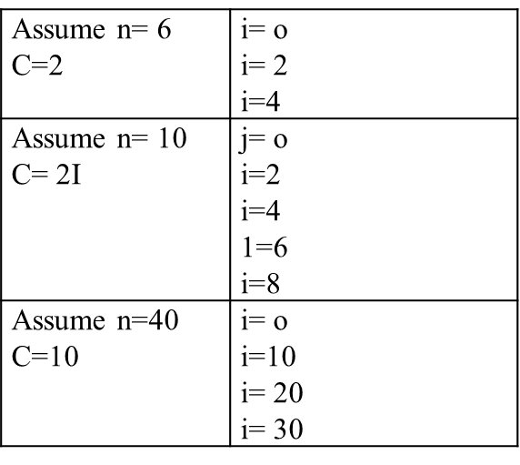
Single Loop behaviour analysis
Complexity - Θ ( n )
for (i= 0 ;i< n; i = i + C )
{
Some Θ(1) work;
}
for (i= n ;i> 0; i = i - C )
{
Some Θ(1) work;
}

Slide 5
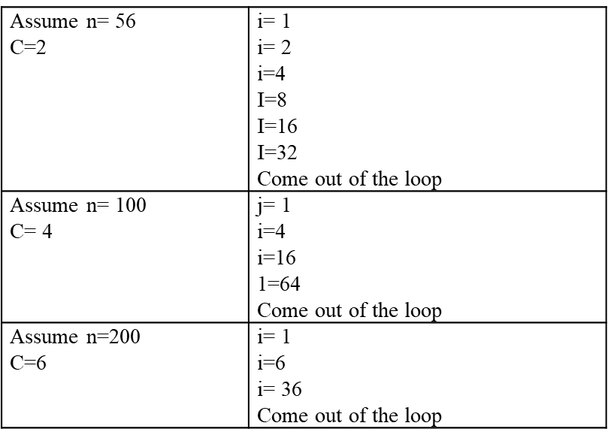
Continued……..
Complexity - Θ ( log n )
for (i= 1;i< n; i = i × C )
{
Some Θ(1) work;
}

Slide 6
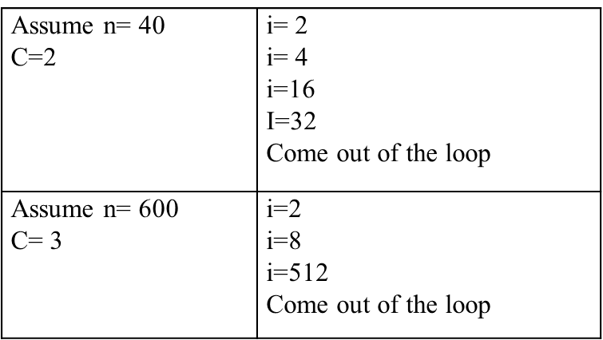
Continued……..
Complexity - Θ( log log n )
for (i= 2;i< n;i = pow( i, c) )
{
Some Θ(1) work;
}

Slide 7
Multiple Loop behaviour analysis
Complexity - Θ (n²)
for(i=1;i<=n;i++)
{
for(j=1;j<=n;j++)
{
Printf(“hello”);
}
}
Value of i | Value of j | Loop executed
1 | 1 to n | N times
2 | 1 to n | N times
3 | 1 to n | N times
n | 1 to n | N times

Slide 8
Continued……..
Complexity - Θ (n⁴).
for (i=1; i<=n; i++)
{
for (j=1; j<=pow(i,2); j++)
{
for (k=1; j<=n/2; k++)
{
printf(“hello”);
}
}
}
Value of i | Value of j | K loop will be executed
1 | 1 to 1 | 1 * n/2 times
2 | 1 to 4 | 4 * n/2 times
3 | 1 to 9 | 9 * n/2 times
n | 1 to n² | n² * n/2 times

Slide 9
Analysis of multiple loops
Consider following loop
for (i=1; i<=n; i++)
{
for (j=1; j<=pow(i,2); j++)
{
for (k=1; j<=n/2; k++)
{
{
printf(“hello”);
}
Value of i | Value of j | K loop will be executed
1 | 1 to 1 | 1 * n/2 times
2 | 1 to 4 | 4 * n/2 times
3 | 1 to 9 | 9 * n/2 times
n | 1 to n² | n² * n/2 times

Slide 10
Analysis of Loops
Important to remember:
Complexity | Explanation
O(1) | When no loops in the code
O(n) | When loop variables are incremented / decremented by a constant amount like i++ or i+=c
O(n^c) | When multiple loops are present the complexity is dependent on the execution of the innermost loop.
O(log n) | When the loop variables are divided or multiplied by a constant like i=i*c or i=i/c where c is constant
O(nlog n) | When the outer or inner loop variable is incremented or decremented and the inner or outer loop variable is multiplied or divided.
O(log log n) | when the loop variables is decremented or incremented exponentially by a constant like i= pow(i,c) where c is constant
Adding the complexities | When various loops are present at different positions in the code, the complexities could be added to get the final complexity.

Slide 11
Recursion tree method for solving recurrences
What is Recurrence Relation?
The process for finding the terms of a sequence in a recursive way is called recurrence relation.
Features of recursive relation:
Next term of the sequence is dependent on the last/previous term
Example notation
X _{n+1} = f (x_{n})
Where X_{n =} n^{th} term
X _{n+1} = next term
Higher order recurrence relations are also possible
Where the nth term is dependent on X _{n-1}, X _{n-2}, X _{n-3} etc terms
Example notation of second order recurrence relation
X _{n+1}=f (X _{n}, X _{n−1})
The recurrence relation Xn+1= X _{n}+ X _{n−1} can generate the Fibonacci numbers.
The recurrence relation for Tower of Hanoi Xn=2Xn−1 + 1

Slide 12
Recursion tree method for solving recurrences
Consider following function
void tryrec ( int n )
{
if (n < = O )
return;
print ( " Hi How are you" );
tryrec (n / 2 );
tryrec(n /2);
}
When n is negative or 0 then the equation simply becomes Θ (0)
Step 1: T (n) = T (n/ 2) + T (n / 2)
Step 2: When n is positive
T (n) = T (n/ 2) + T (n / 2) + Ɵ (1)
= 2 T (n / 2) + Ɵ (1)

Slide 13
Solving Recurrence
Void tryrec (int 7)
{
if (n < = 0 )
return;
for ( int i = 0;i< n; i + + )
printf ( " Hi Hello" );
tryrec(n / 2);
tryrec( n / 3 );
}
Step 1: write recurrence relation
When n > 0
T (n) = T (n / 2) + T (n / 3)
Step 2: Adding constant to relation
T (n) = T (n / 2) + T (n / 3) + Ɵ (n)

Slide 14
Continued……..
Let's solve one more problem
void try rec ( int n )
{
if (n<= 1)
return;
print (" Hi , Hello");
tryrec(n-1);
}
Step 1&2: write a recursive relation and add constant to it.
n> 1
T (n) = T (n – 1) + t Ɵ (1)
n= 1
T (1) = Ɵ (1)

Slide 15
Recursion Tree method
Recursion Tree method
Substitution Method
Iteration Method
Recursion Tree Method
Master Method
Remember
1. To write the non – recursive part of the tree as root.
2. To write the recursive part as the children.
3. To write down the amount of work done at each node.
4. To keep expanding till we find some pattern.

Slide 16
Continued……..
Recursive relation of merge sort T ( n ) = 2 T (n / 2 )+ C n
2 T (n/2) -------Recursive part
C n --------------Constant

Slide 17
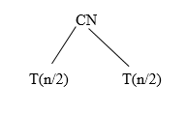
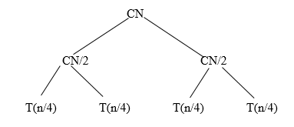
Continued……..
Draw recursive tree: Take the non-recursive part as the root and take the recursive part as the children.
2. This recursive relation contains two recursive calls so write two children.
3. Compute the total work done. So at level 1-- work done is Cn.
At level 2 -- work done is cn / 2 + cn / 2= cn
4. In total at every level the cn work is done.
5. Find out how many levels there are. In short, find out the height of this
binary tree.
Let’s find the expression for the height of the tree - [log 2 n ] + 1
6. Once you are able to find the height of the tree you can compute the total work done.
7. In the above example at every level Cn work is done so the total work done
may be Cn + Cn + Cn + Cn………. + Cn = Θ (nlog₂n)

Slide 18
Continued……..
8. Find number of nodes present at every level
0th Level has 2⁰ nodes- 1 node
1st Level has 2¹ nodes- 2 nodes
2nd Level has 2² nodes - 4 nodes
Continuing in similar manner, we have-
Level-log ₂ n has 2 ^{log}₂^{n} nodes
9. Calculate cost of last level-
Cost of last level = n * T (1) = Θ (n)
10. Find the asymptotic expression values and not the exact values. So for the above example work done becomes
Θ (nlog₂n)

Slide 19
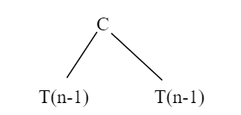
Continued……..
Tower of Hanoi Problem Recurrence relation
T(n)=2T(n-1)+C
T(1)=C
Draw recursive tree: Take the non-recursive part as the root and take the recursive part as the children.
2. This recursive relation contains two recursive calls
so write two children.

Slide 20
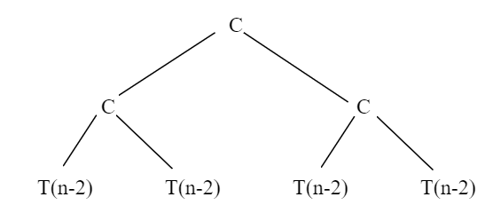

Continued……..
3.Compute the total work done. Work done at
Level 0- - - - C
Level 1- - - - 2C
Level 2- - - - 4C
4. Find out how many levels there are. In short, find out the
height of this binary tree.
5. Use the expression for the height of the tree
[log 2 n ] + 1
6. For any value of n, you will be Having n Levels
Total Work Done = C+2C+4C+- - - -
= C (1+2+4+ - - - - - )
Total work done = $θ$ (2n)
7. Therefore, the asymptotic expression values and not the exact values could be written. So for the above example work done becomes $θ$ (2^{n})

Slide 21

Continued……..
T(n)=T(n/2) + C
T(1)=C
1. Draw recursive tree: Take the non-recursive part as the root and take the recursive part
2. This recursive relation contains only one recursive call
3. Compute the total work done. Work done at
Level 0- - - - C
Level 1- - - - C
Level 2- - - - C

Slide 22
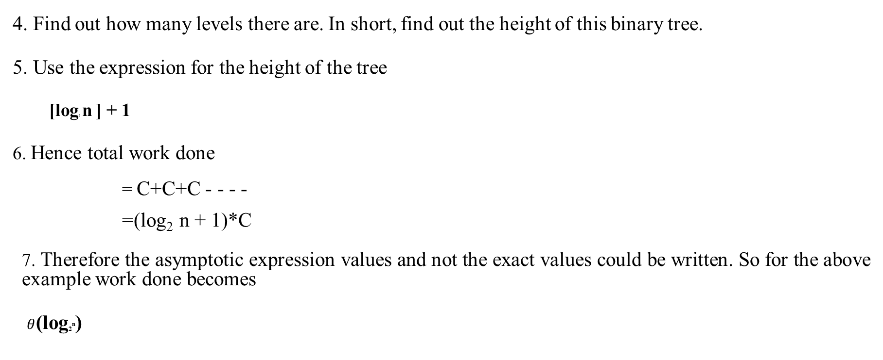
Continued……..
4. Find out how many levels there are. In short, find out the height of this binary tree.
5. Use the expression for the height of the tree
[log₂ n ] + 1
6. Hence total work done
= C+C+C - - - -
=(log₂ n + 1)*C
7. Therefore the asymptotic expression values and not the exact values could be written. So for the above example work done becomes
$θ$(log₂^{n})

Slide 23
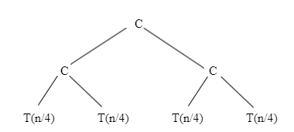
Continued……..
Consider the following recurrence relation which
T(n)=2T(n/2) + C
T(1)=C
1. Draw recursive tree: Take the non-recursive part as the root and take the recursive part
2. This recursive relation contains two recursive calls so write two children.
3. Compute the total work done. Work done at
Level 0- - - - C
Level 1- - - - 2C
Level 2- - - - 4C

Slide 24

Continued……..
4. Find out how many levels there are. In short, find out the height of this binary tree.
5. Use the expression for the height of the tree [log₂ n ] + 1
6. Hence total work done - Total Work done $θ$ (n)

Slide 25
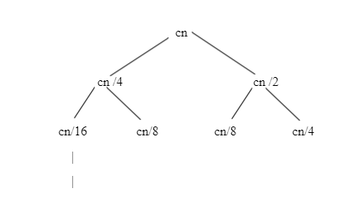
Recursion Tree Method to determine upper bound
Consider relation
T(n)=T(n/4)+T(n/2)+CN
T(1)=C
Draw the recurrence tree
By going further we will get

Slide 26
Continued……..
3. Now you might have guessed the Pattern
4. Work done at level 0- - - - - Cn
at level 1- - - - - 3Cn/4
at level 2- - - - - 9Cn/16
5. You might have observed that it is a geometric progression with r = 3/4 up to a certain point because leaf nodes are not at the same level.
6. The left side of the tree is going to end earlier than the right side of the tree.
7. As you can see, the left side is being divided by 4 and the right side is being divided by 2

Slide 27
Continued……..
8. To find the exact bound becomes very difficult in such cases. By making the assumption that
the tree is full; the value calculated may be more than that of the actual value because we are
performing less work. That is what the upper bound is.
9. Total work done
Cn+3Cn/4+9Cn/16- - - - - - - - (log n) terms in series.
10. To find the upper bound we will use big oh notation.

Slide 28
Space Complexity
Space complexity it is defined as the order of growth of memory or RAM Space in the terms of input size.
Space complexity: Ɵ(1)
int calculate ( int n)
{
return n 12+5)/2;
}
In the above example depending on the input size the number of variable do not changers.
Consider that n= 10000 then also variable remains only one.

Slide 29
Continued……..
Space complexity: Ɵ(1)
{
int sum=0;
int i = 0 ;
for ( i=1 ; i<=( n-5 ); i+ + )
sum= sum +i;
return sum;
}
In the above example also the input size doesn't make any difference for number of variables.
Hence the space complexity doesn’t change.

Slide 30
Continued……..
Space Complexity : Ɵ (n) or O (n)
int sumarray( int arrone [ ], int n)
{
int sum=0;
for (i = O; i < n; i + + )
sum = sum + arrone [ i ];
return sum;
}
Input array is of size 1000 then complexity will be different than that of if the array size is suppose 10000.

Slide 31
Space complexity of Auxiliary space
Auxiliary Space: This term refers to the order of growth of extra space or temporary space in terms of input size.
Space complexity : Ɵ (n) Auxiliary space = Ɵ (1)
int sumarr ( int arrone [ ],int n )
{
int sum=0;
for (int i = 0;i < n;i + + )
sum =sum +arrone [i];
return sum;
}
Note : The space complexity for programs using array will be at least Ɵ (n)

Slide 32
Thank you

